Slide 1

Improving Real-World
Key Challenges & Practical Solutions
RAG
Systems

Slide 2
Understanding RAG Systems

Slide 3










What is
a
RAG
System?
APIs
Response
Raw Files
User
Vector Stores
Query
Databases

Slide 4
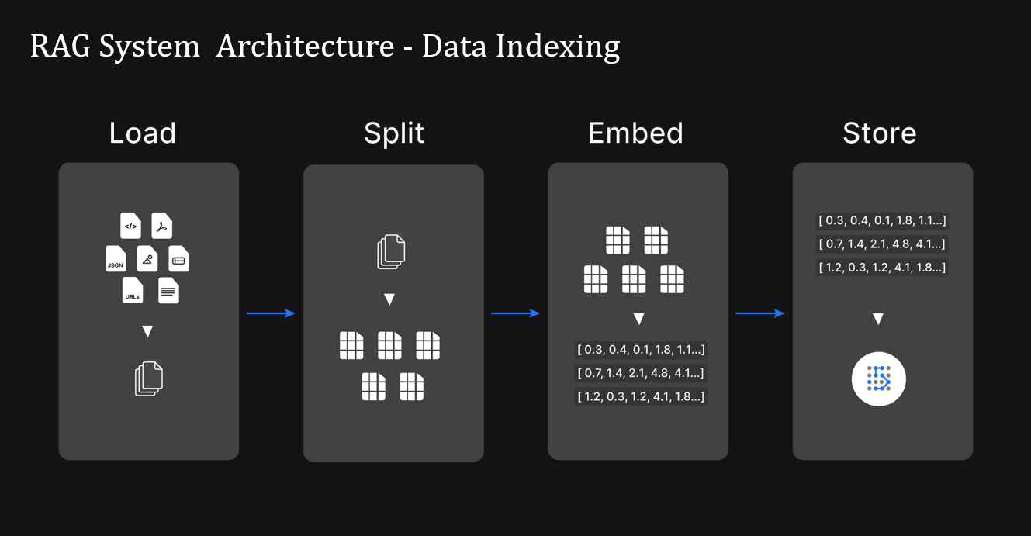

Slide 5
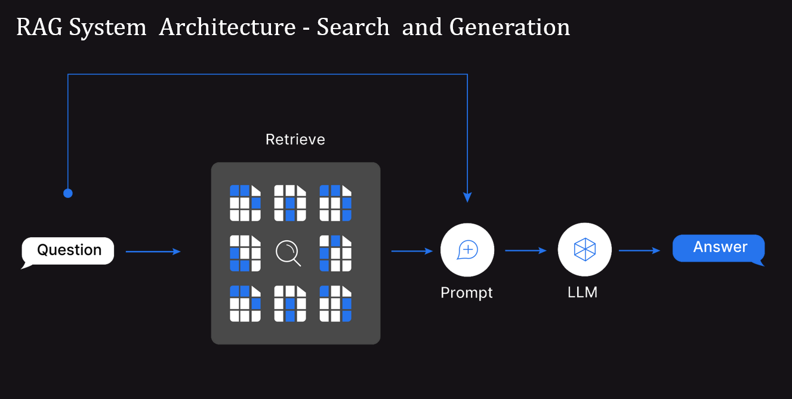
RAG System Architecture - Search and Generation

Slide 6
RAG System Challenges & Practical Solutions

Slide 7
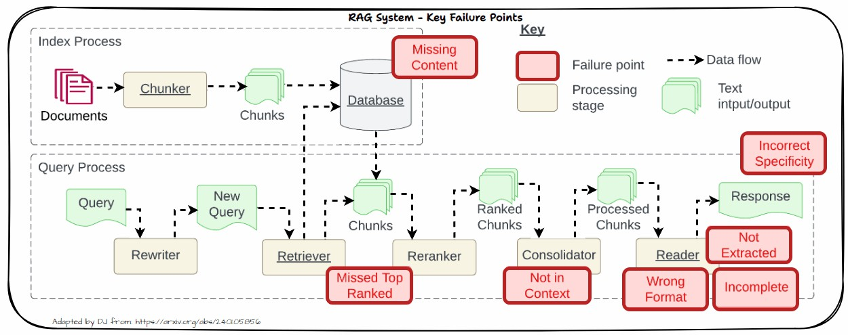
Key
Failure
or
Pain
Points
in
a
RAG
System
Source: Seven Failure Points When Engineering a Retrieval Augmented Generation System

Slide 8
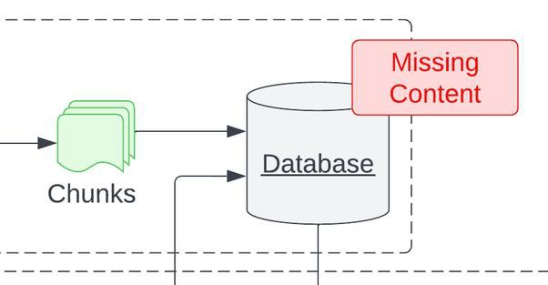
Problem: Missing Content
•
Missing Content means the relevant context
to answer the question is not present in the database
•
Leads to the model giving a wrong answer
and hallucinating
•
End users end up being frustrated with
irrelevant or wrong responses
Source: Seven Failure Points When Engineering a Retrieval Augmented Generation System

Slide 9



Solutions
for
Missing
Content
Better data cleaning using tools like
unstructured.io to ensure we extract
good quality data
Better prompting to constrain the
model to NOT answer the question if
the context is irrelevant
Agentic RAG with search tools to get
live information for question with no
context data
Source: Seven Failure Points When Engineering a Retrieval Augmented Generation System

Slide 10
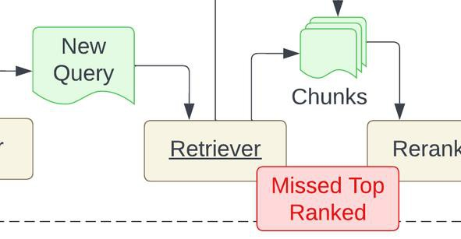
Problem: Missed Top Ranked
•
Missed Top Ranked means context
documents don’t appear in the top retrieval
results
•
Leads to the model not able to answer the
question
•
Documents to answer the question are
present but failed to get retrieved due to poor retrieval strategy
Source: Seven Failure Points When Engineering a Retrieval Augmented Generation System

Slide 11
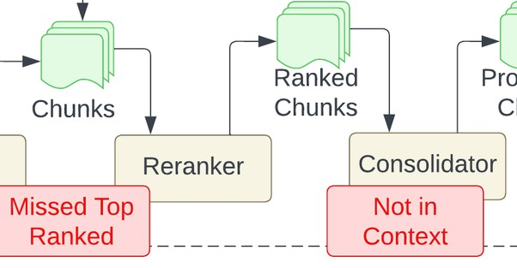
Problem: Not in Context
•
Not in Context means documents with the
answer are present during initial retrieval
but did not make it into the final context for
generating an answer
•
Bad retrieval, reranking and consolidation
strategies lead to missing out on the right documents in context
Source: Seven Failure Points When Engineering a Retrieval Augmented Generation System

Slide 12
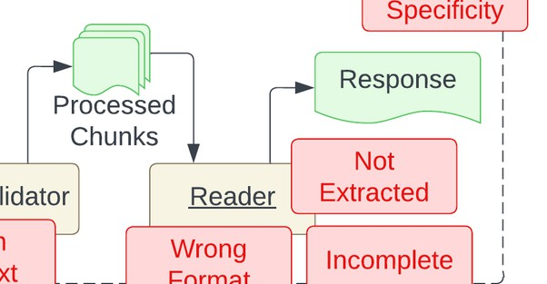
Problem: Not Extracted
•
Not extracted means the LLM struggles
extract the correct answer from the
to
provided context even if it has the answer
•
This occurs when there is too much
unnecessary information, noise or contradicting information in the context
Source: Seven Failure Points When Engineering a Retrieval Augmented Generation System

Slide 13
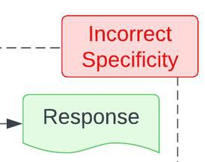
Problem: Incorrect Specificity
•
Output response is too vague and is not
detailed or specific enough
Vague or generic queries might lead to not getting the right context and response
•
•
Wrong chunking
this problem
or
bad
retrieval
can
lead
to
Source: Seven Failure Points When Engineering a Retrieval Augmented Generation System

Slide 14
•
Use
Better Chunking Strategies
•
Hyperparameter Tuning - Chunking
&
Retrieval
Solutions for Missed
Top Ranked, Not in
Context & Incorrect
Specificity
•
Use
Better Embedder Models
•
Use
Advanced Retrieval Strategies
•
Use
Context Compression Strategies
•
Use
Better Reranker Models
Source: Seven Failure Points When Engineering a Retrieval Augmented Generation System

Slide 15
Experiment
with
Various Chunking Strategies
Splitter Type
Description
RecursiveCharacterText
Splitter
Recursively splits text into larger chunks based on several defined
LangChain’s recommended way to start splitting text
characters.
Tries to keep related pieces of text next to each
other.
CharacterTextSplitter
Splits text based on a user defined character. One of the simpler text splitters
tiktoken
Splits text based on tokens using trained LLM tokenizers like GPT-4
spaCy
Splits text using the tokenizer from the popular NLP library - spaCy
SentenceTransformers
Splits text based on tokens using trained open LLM tokenizers available
from the popular sentence-transformers library
unstructured.io
The unstructured library allows various splitting and chunking including splitting text based on key sections and titles
strategies

Slide 16
Hyperparameter
Tuning
-
Chunking
&
Retrieval
Generate
Answer
LLM
Context:
-----------
Question:
-----------
Answer
-----------
Chunk
Size = C
Top_K=K
Sim_thresh = S
Eval
Metrics
Vector DB
C Value
Space
K Value
S Value Space
Space
500
5
0.2
1,000
8
0.3
2,000
10
0.5

Slide 17
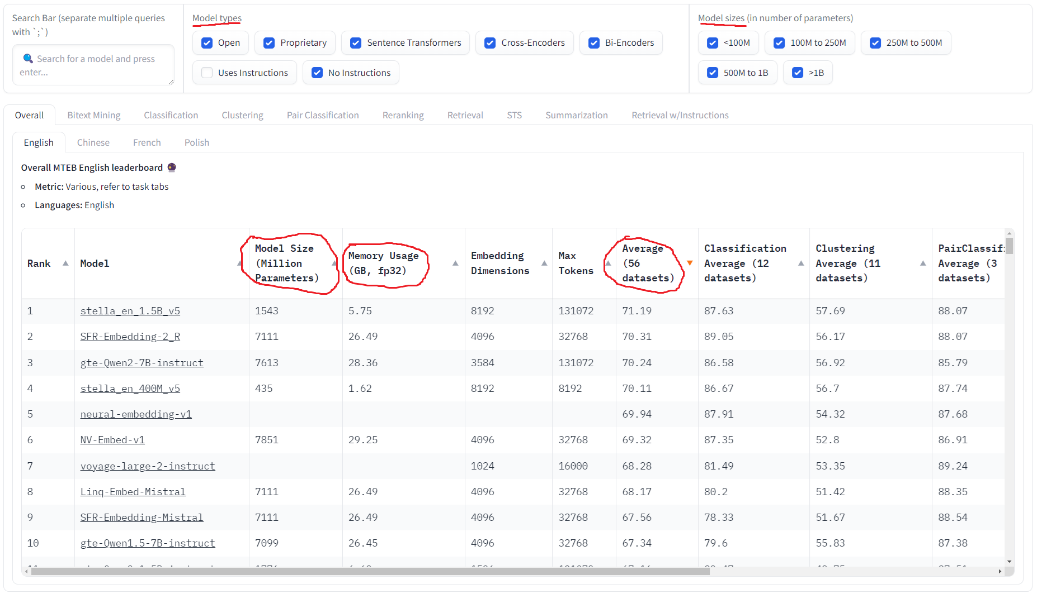
Better Embedder Models - MTEB Leaderboard

Slide 18
Better Embedder
Models - Experiment
Yourself
hello world
Embedding
models
-0.027
-0.001
-0.020
.......
-0.023
Text
Text as vector
•
Newer Embedder
Models will be trained
on more data and often better
•
Don’t just go by benchmarks, use and experiment on your data
•
Do not use commercial models if data privacy is important

Slide 19
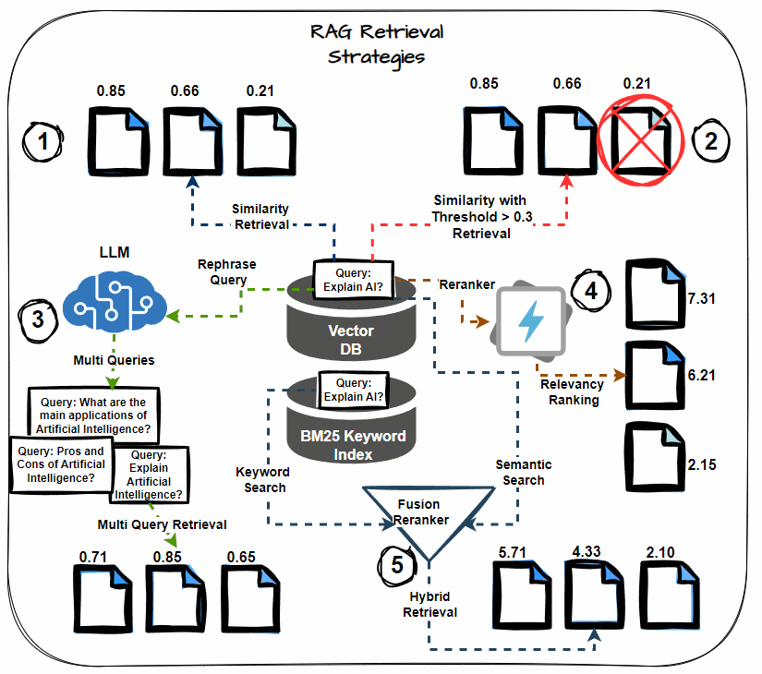
Advanced Retrieval Strategies
•
Semantic Similarity Thresholding
•
Multi-query Retrieval
•
Hybrid Search (Keyword + Semantic)
•
Reranking
•
Chained Retrieval

Slide 20
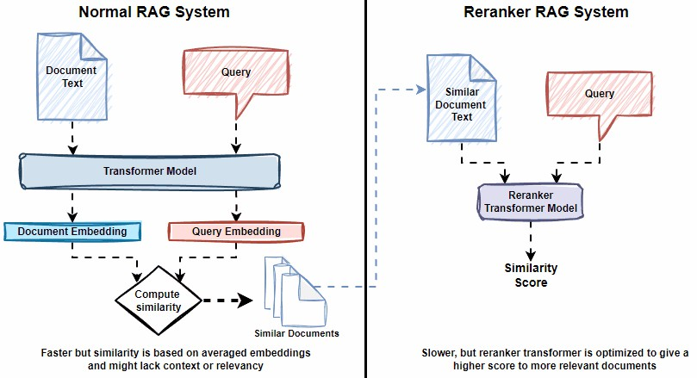
Better Reranker Models
•
Rerankers are fine-tuned cross-encoder
transformer models
•
These models take in a pair of documents
(Query, Document) and return back a relevance score
•
Models fine-tuned on more pairs and
released recently will usually be better

Slide 21
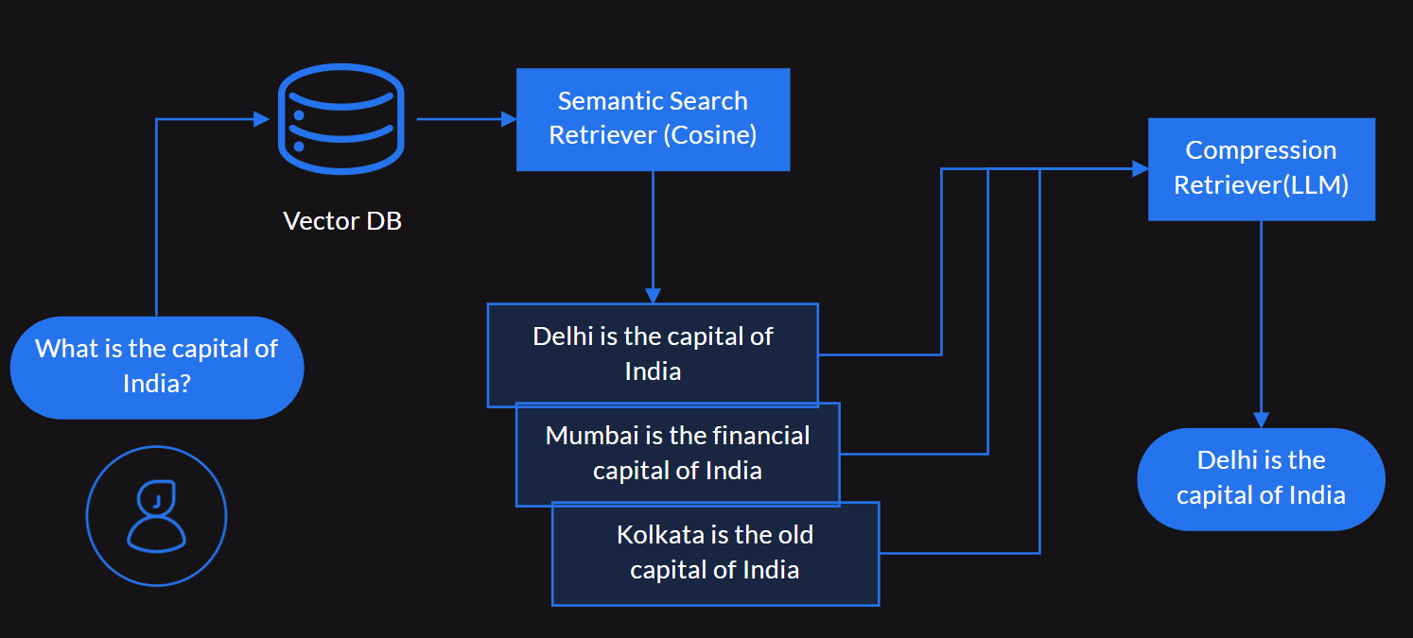
Context Compression Strategies
•
LLM prompt-based Context
Compression
• Extractor: Filters out content from context document
related to query
• Filter: Filters out whole context documents related to query
•
Microsoft LLMLingua Prompt
Compression

Slide 22
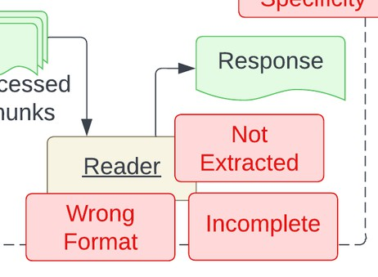
Problem:
Incorrect
Specificity
•
The output response is in the wrong format
•
It happens when you tell the LLM to return the
response
in
a
specific
format
e.g
JSON
and
it
fails
to
do
so
Source: Seven Failure Points When Engineering a Retrieval Augmented Generation System

Slide 23


Solutions
for
Wrong
Format
Powerful LLMs have native support for
response formats e.g OpenAI supports
JSON outputs
Better Prompting and Output Parsers
Structured Output Frameworks
Source: Seven Failure Points When Engineering a Retrieval Augmented Generation System

Slide 24
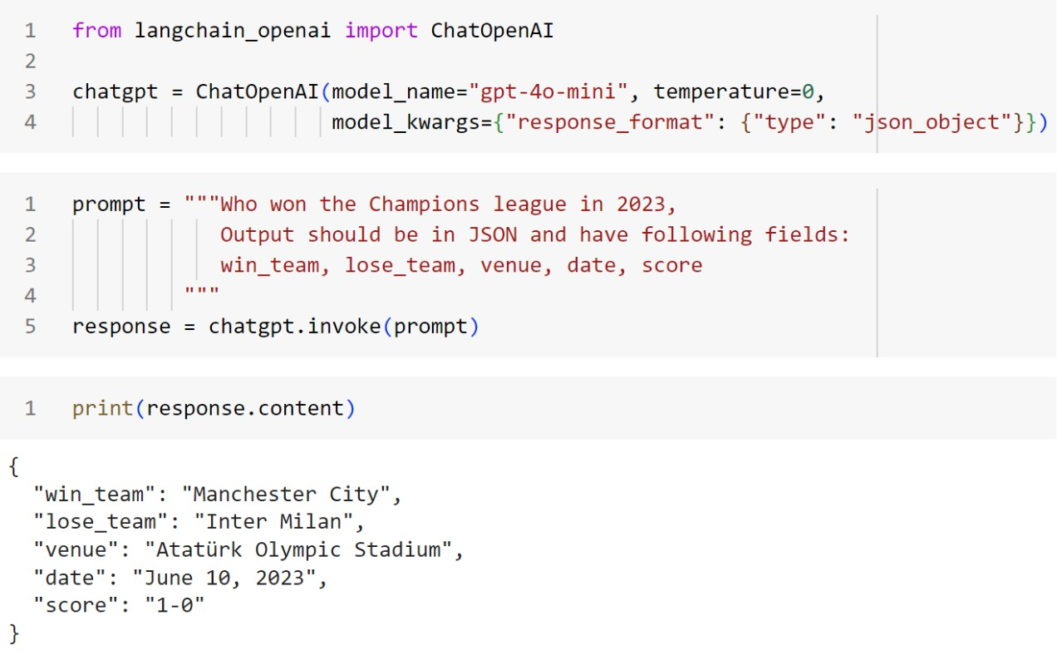
Solutions for Wrong Format - Native LLM Support

Slide 25
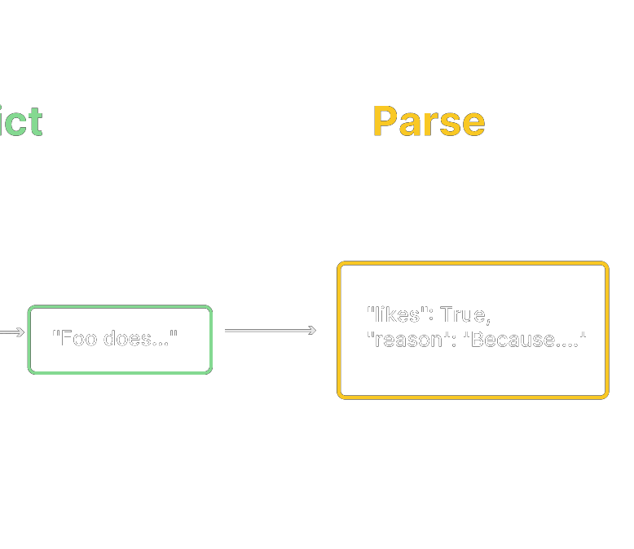

Solutions for Wrong Format - Output
Parsers
&
Better
Prompting
•
LangChain allows to convert the raw LLM
response into a more consumable format using Output Parsers.
by
•
There exists a variety of parsers including:
•
•
•
•
String parser
CSV parser Pydantic parser JSON parser

Slide 26
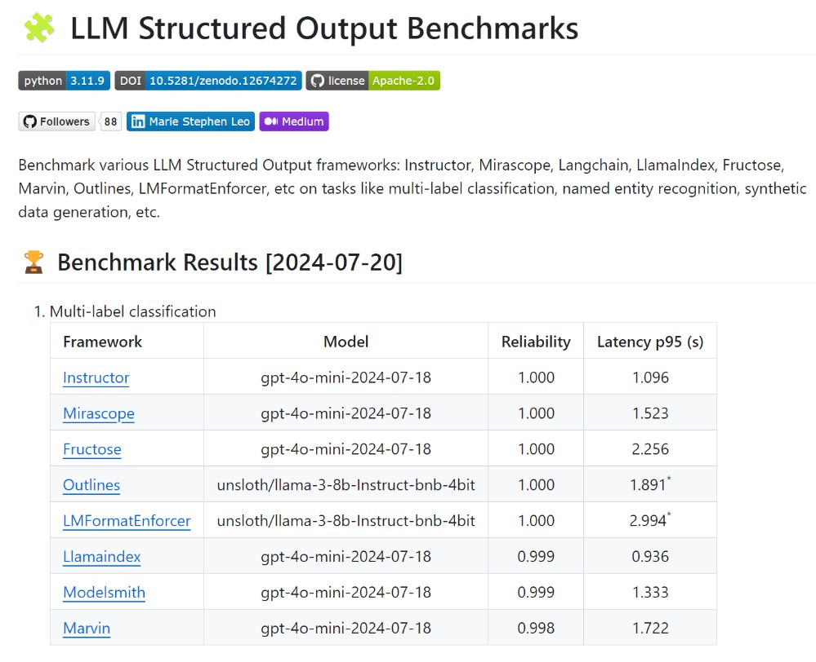
Solutions for Wrong Format - Structured Output Frameworks

Slide 27
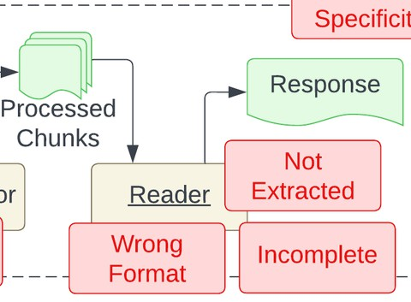
Problem:
Incomplete
•
Incomplete means the generated
incomplete
response is
Reader
•
This could be because of poorly worded questions,
lack
of
right
context
retrieved,
bad
reasoning
Source: Seven Failure Points When Engineering a Retrieval Augmented Generation System

Slide 28


Solutions
for
Incomplete
Use Better LLMs like GPT-4o, Claude 3.5 or
Gemini 1.5
Build Agentic Systems with Tool Use if
necessary
Use Advanced Prompting Techniques like
Chain-of-Thought, Self-Consistency
Rewrite User Query and Improve Retrieval -
HyDE
Source: Seven Failure Points When Engineering a Retrieval Augmented Generation System

Slide 29
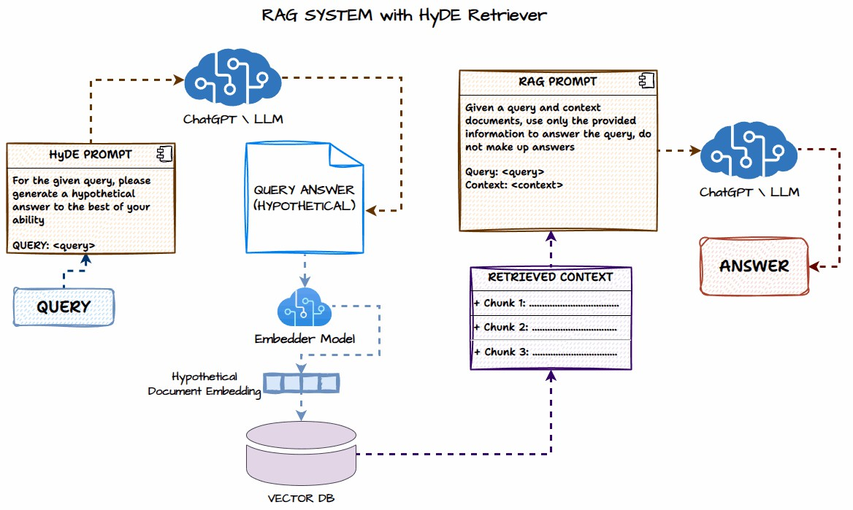
HyDE - Hypothetical Document Embedding

Slide 30
Other enhancements from recent Research Papers

Slide 31
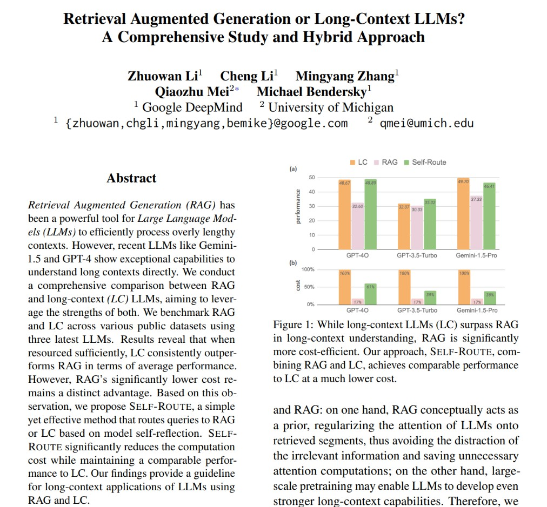
RAG
vs.
Long
Context
LLMs
• Long Context LLMs often outperform RAG but are very
expensive in terms of computing and cost
• Hybrid approach where you can use an LLM to reflect
and see if the RAG answer is good enough or route to
Long Context LLM

Slide 32
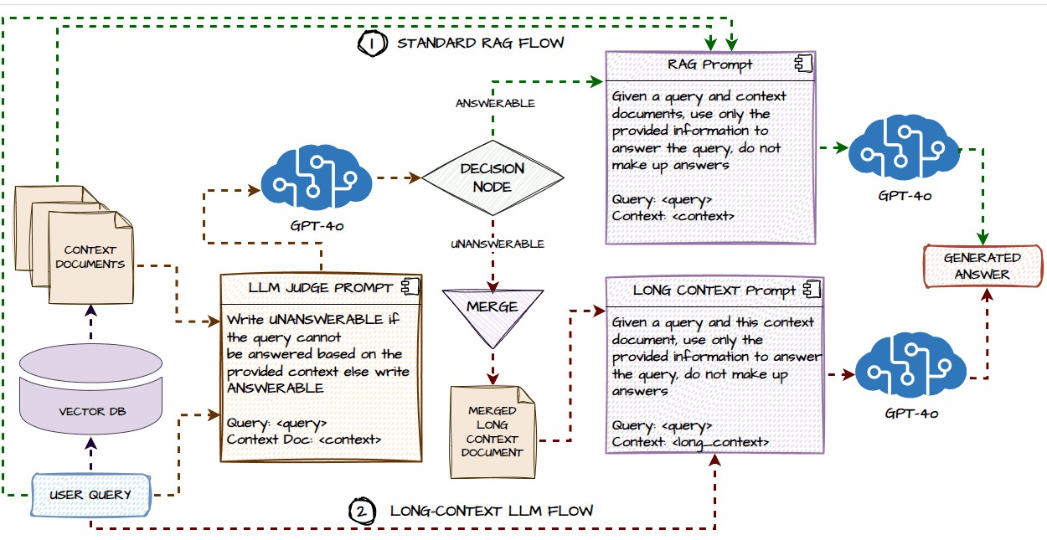
RAG vs Long Context LLMs - Self-Router RAG

Slide 33
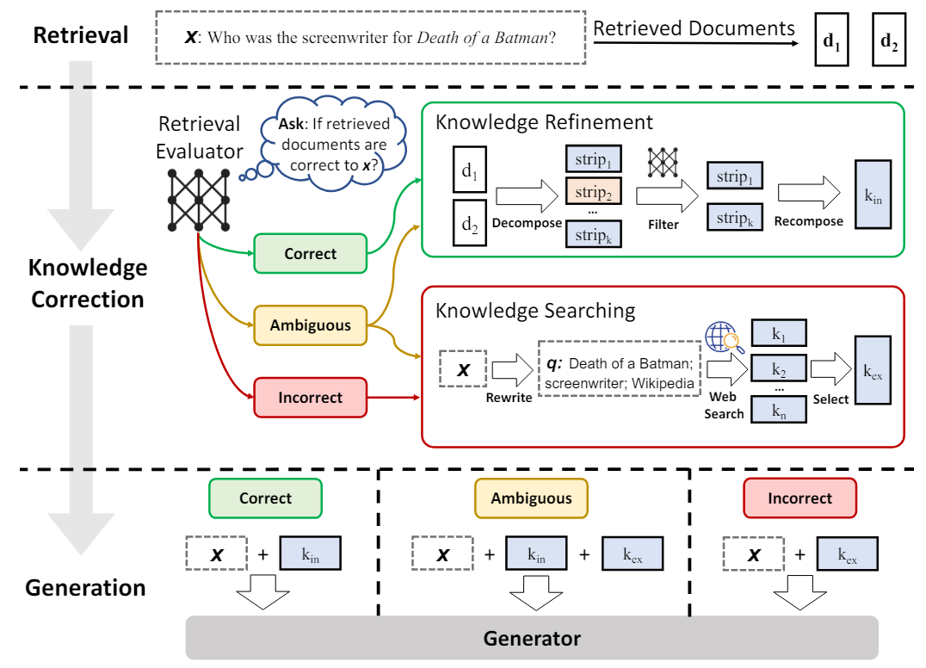
Agentic
Corrective
RAG
•
Step 1:
•
Retrieve context documents from vector database from the input query
•
Step 2:
•
Use an LLM to check if retrieved documents are relevant to input
question
•
Step 3:
•
If all documents are relevant (Correct), no specific action needed
•
Step 4:
•
If some or all documents are not relevant (Ambiguous OR Incorrect),
rephrase the query and search the web to get relevant context information
•
Step 5:
•
Send rephrased query and context documents or information to the
LLM for response generation
Source: Corrective Retrieval Augmented Generation; https://arxiv.org/abs/2401.15884

Slide 34
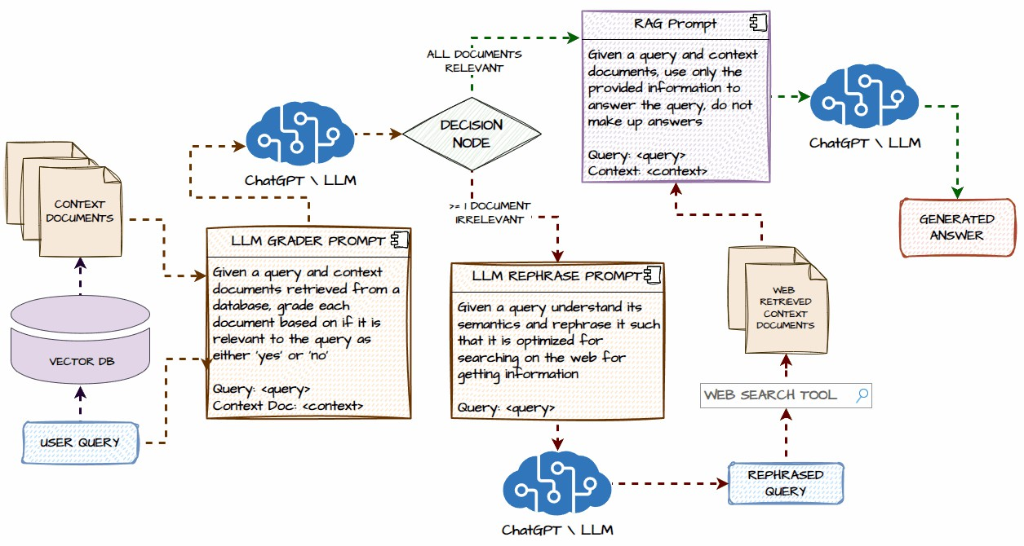
Agentic
Corrective
RAG
Source: https://www.analyticsvidhya.com/blog/2024/07/building -agentic-rag-systems-with-langgraph/

Slide 35
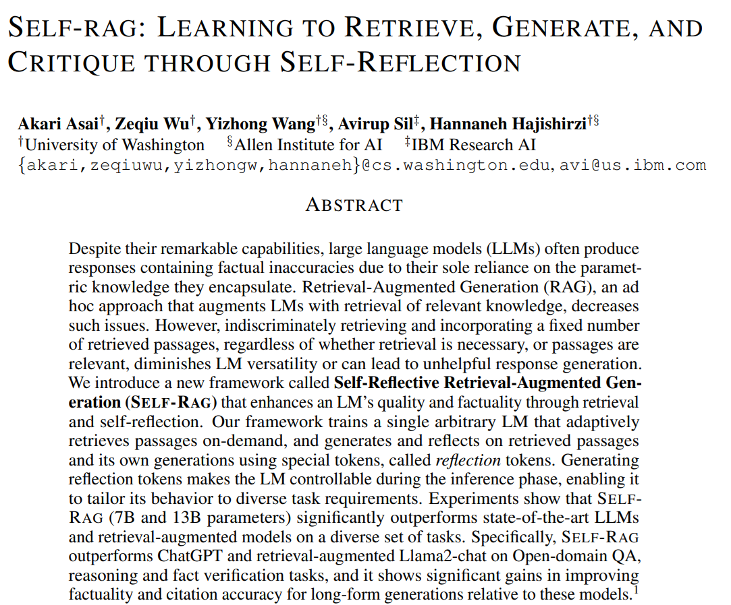
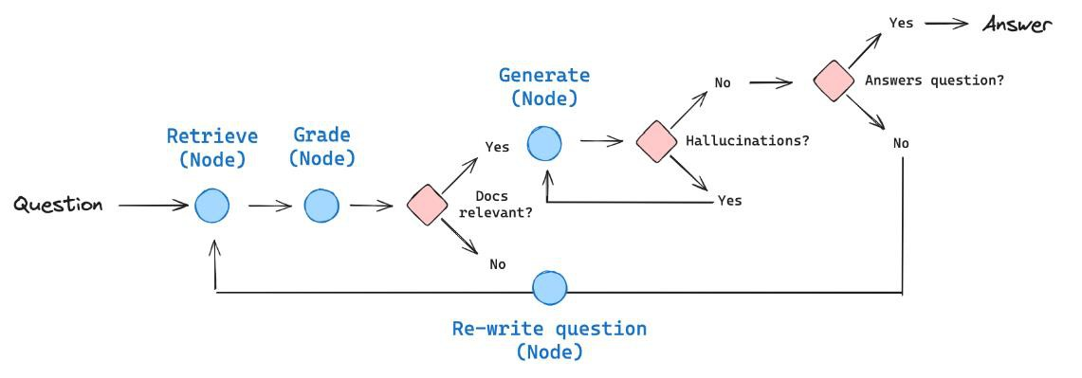
Agentic
Self-Reflection
RAG
Source: Self-RAG: Learning to Retrieve, Generate, and Critique through Self-Reflection; https://arxiv.org/abs/2310.11511

Slide 36
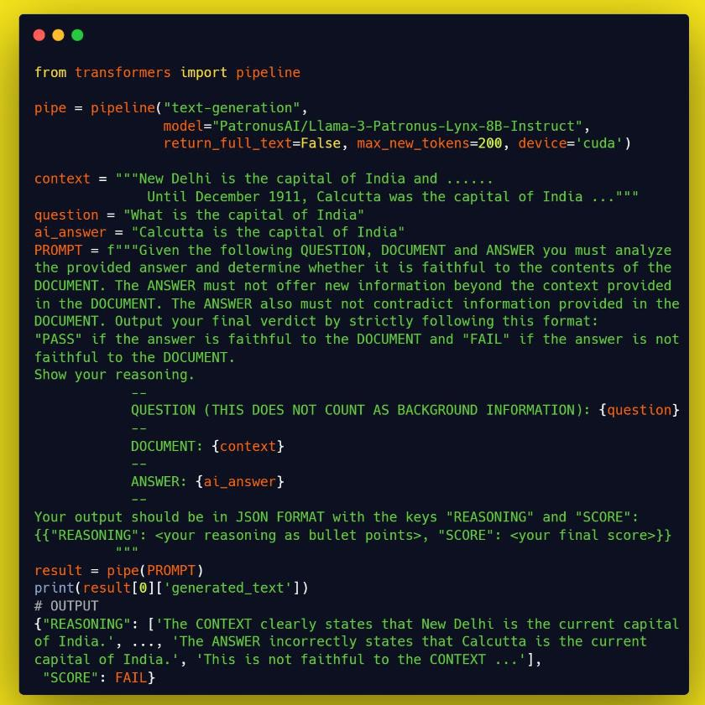

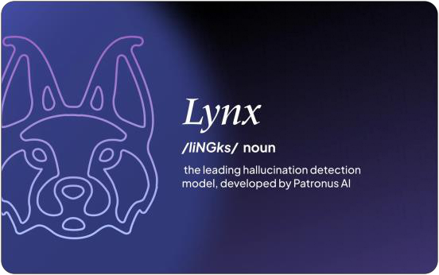

Recent
LLMs
to
Check
Hallucinations
•
GPT-4o
from
OpenAI
•
Lynx from PatronusAI
Source: Lynx: An Open Source Hallucination Evaluation Model; https://arxiv.org/abs/2407.08488

Slide 37



RAG is still very much a
retrieval problem
Build an evaluation dataset and
always evaluate your RAG
system
Explore various chunking and
retrieval strategies, don’t stick
to default settings
Even with Long Context LLMs,
RAG isn’t going anywhere (for
now)
Key Takeaways
Agentic RAG systems are the
future

Slide 38
Thank You

